Slide 1
Human-in-the-Loop Object-Goal Navigation in Household Settings
CS 7633 HRI Fall 2025
Project Final Presentation
Nhi (Leona) Nguyen, Mengyin (Cassie) Lin, Yi (Cherry) Lian

Slide 2
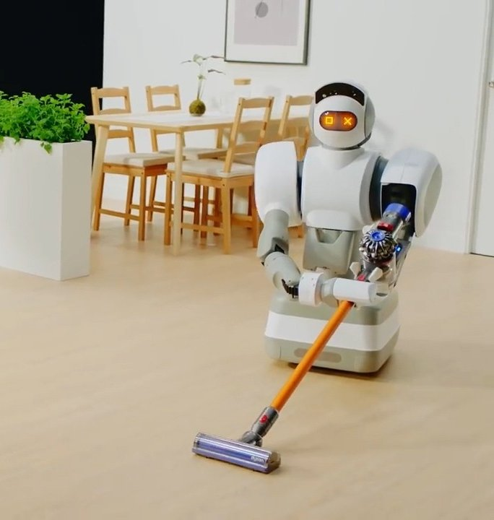




Introduction & Motivation
Goal: Enable robots to perform object-goal navigation in household environments while adapting their motion to ongoing human activities, ensuring safe, comfortable, and minimally disruptive behaviour
Household environments are dynamic, shared spaces where humans move, perform tasks, and frequently interact with objects
Robots need to reach target objects, but doing so naively can cause obstruction, discomfort, or inefficient human-robot coexistence
Most existing navigation systems focus only on collision avoidance, which ignores important aspects of social acceptability such as predictability, legibility, and respecting personal/working space.
By incorporating the human in the loop, the robot can adjust its path based on the human’s current task, motion patterns, and proximity, leading to more natural and socially aware object-goal navigation

Slide 3
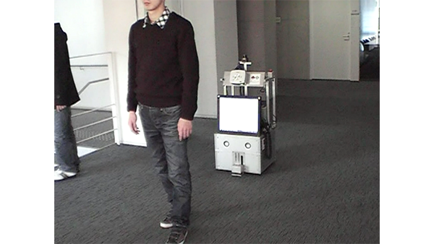
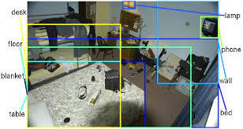
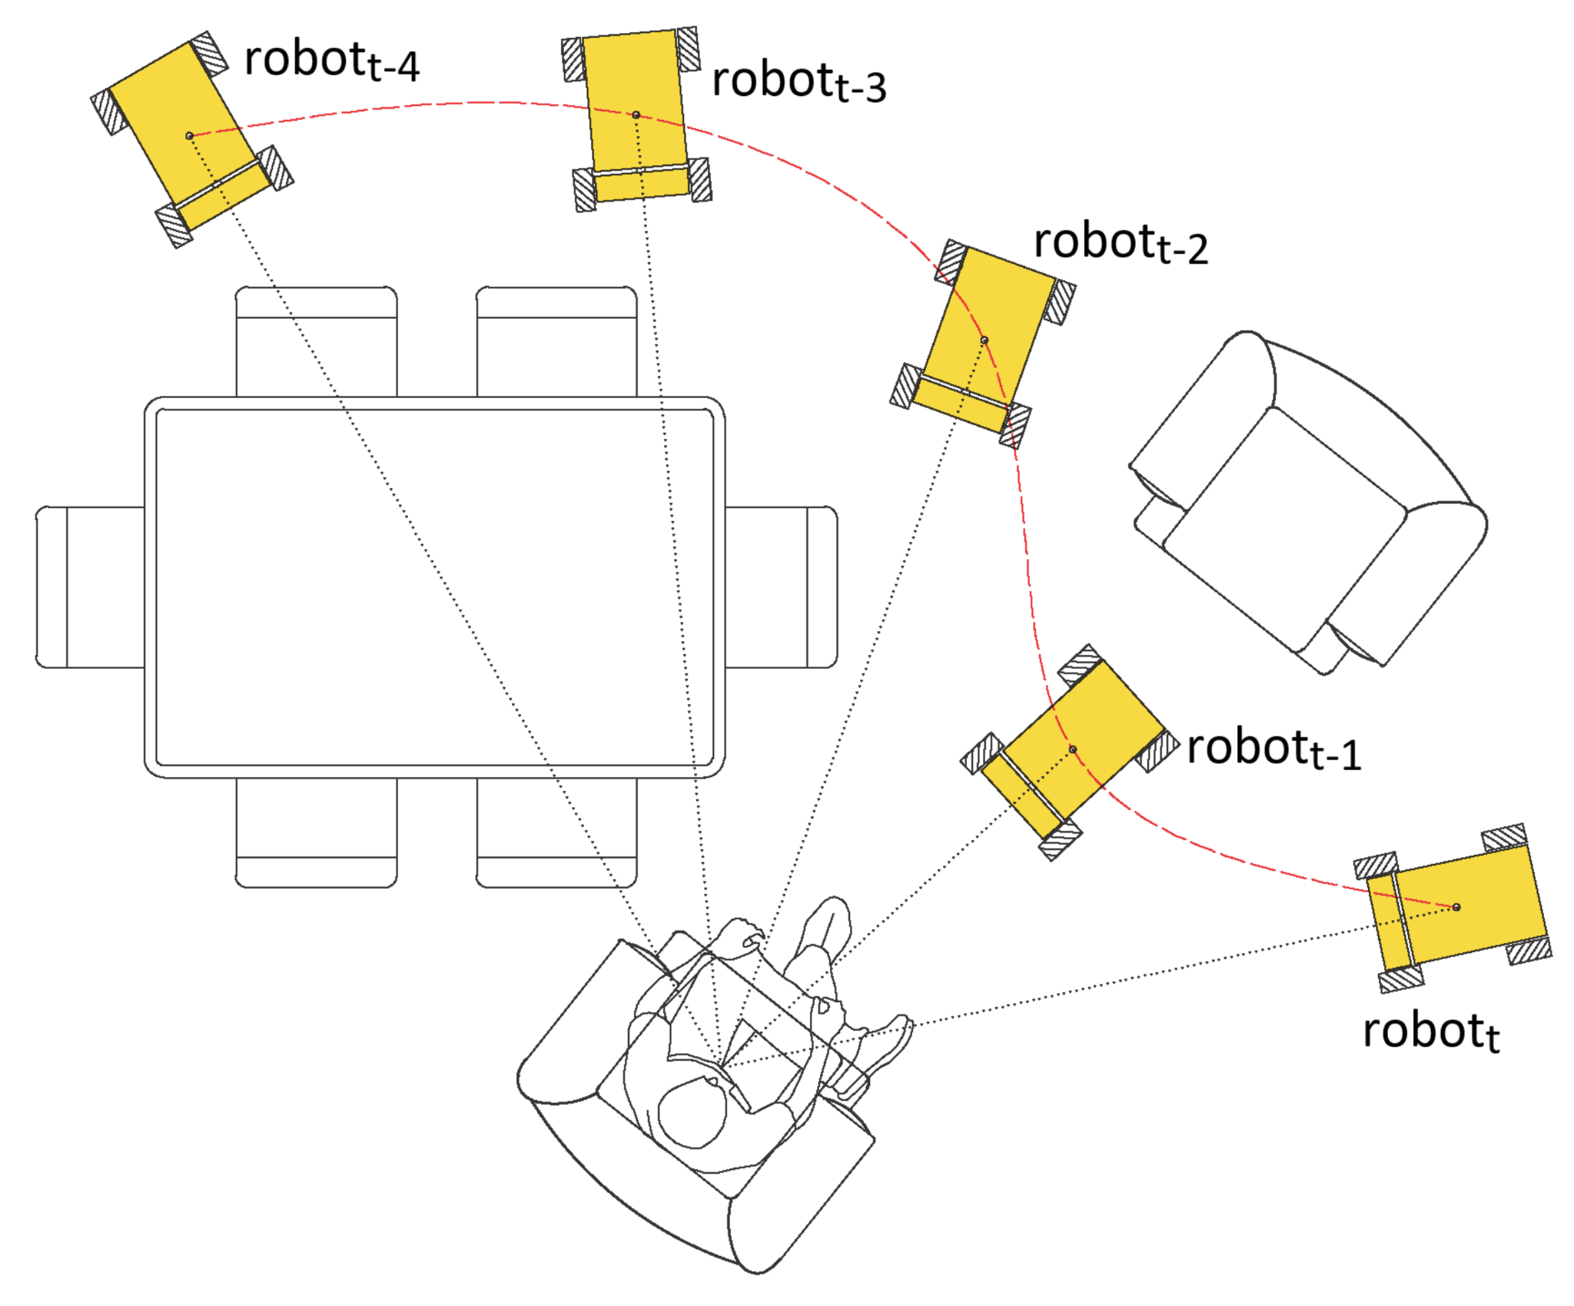
Research Question / Objective
We aim to design a household robot that can navigate toward object goals while dynamically adapting to human presence in shared environments. The robot should be able to:
1.
Minimize disturbance by avoiding overly intrusive behaviours.
2.
Adjust its path to give human priority and avoid interfering with ongoing human-object interactions.
3.
Optimize travel time and maintain goal accuracy.

Slide 4
Proposed Methodology
Overall Picture and Challenges
Human Modelling
Robot Planning
A dynamic agent with non-cooperative behavior, can be considered as moving with unknown intentions.
Decision making on partial observation of another agent
Have no access to ground truth human position, solely rely on sensor inputs
Need to model human agent presence distribution for human-aware planning
Need to copy with uncertainty since human is not guaranteed to be in sight every frame

Slide 5
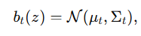
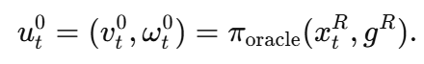
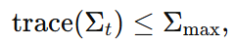
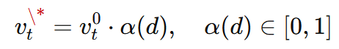
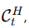
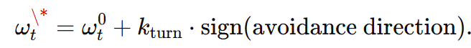
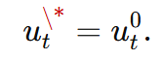
Proposed Methodology
Problem Formulation: use Gaussian belief to model human location on the plane
4
Human-Aware Navigation as a Constrained Control Problem
Habitat navigation stack gives a nominal control
We adjust this action so the robot:
stays close to
avoids entering the predicted human corridor
but only when the human estimate is confident.
Given belief
Condition of belief reliable:
When belief is reliable:
Slow down speed ∝ distance
Steer away from human
When belief is too uncertain:

Slide 6
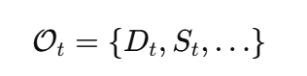
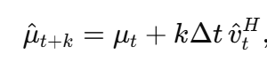
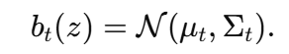
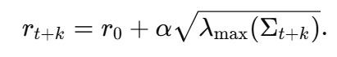
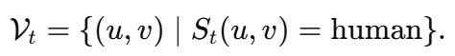

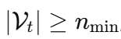
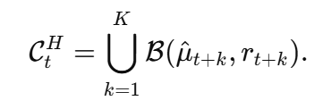
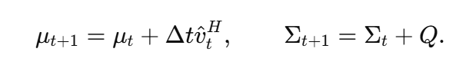
Proposed Methodology
Problem Formulation: use Gaussian belief to model human location on the plane
1
2
3
Human State Estimation via Segmentation + Depth
Belief Over Human Position
Predictive Human Motion Corridor
Robot Observation (depth, segmentation mask…)
Set of human pixels
Human visible case: construct human pcd to obtain human position
Maintain a Gaussian belief over human location on the ground plane
Observation Update (Visible)
Prediction Update (Invisible)
The next K-step predicted human positions:
Uncertainty-informed radius:
The motion corridor:
Notes:
Q = process noise covariance, controls how quick uncertainty grows. diag(0.5, 0.5) in implementation

Slide 7
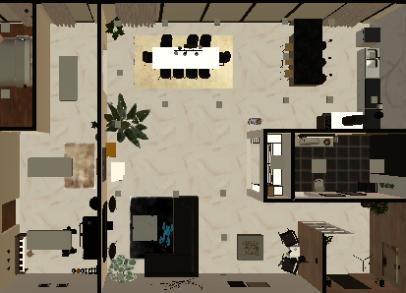

Proposed Methodology
Intuitions about the motion corridor
Human Visible Case
Human Invisible Case
v
v

Slide 8
Proposed Metrics
Disturbance metrics
Robot-human min distance timeline
Average intrusion fraction
Distribution of intrusion durations
Task success
Task success percentage
Task completion steps
To captures how much the robot interferes with the human’s task, which is the main objective of human-aware navigation
To ensures that reducing disturbance does not compromise the robot’s ability to complete its tasks effectively

Slide 9



Experiment
Our settings
Two scenarios
Human-Only: The human completes their tasks while the robot does not move.
Human with Robot: The human performs their tasks while the robot navigates to assigned object goals in the environment. The robot will not navigate to the object currently being manipulated by the human.
Human performs household tasks based on natural-language instructions. For example:
“Place the candle and candle holder on the white table in the living room. Move the plant to the same table.”
#NotAdversarial
#NotCollaborative

Slide 10

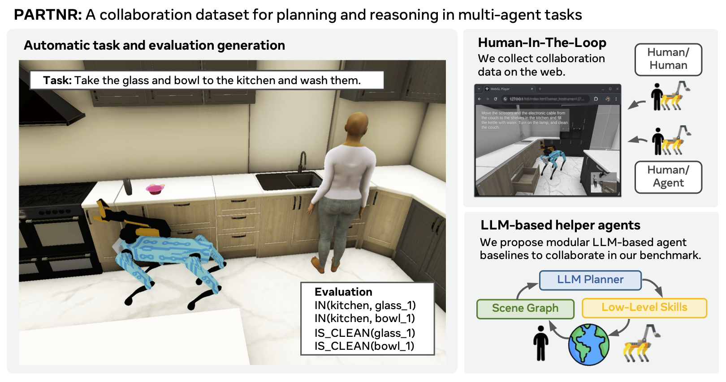

Experiment Setup
Modified the PARTNR codebase to support human-only tasks and implemented a scripted planner that controls the robot’s object-goal navigation.
Built our experiment on PARTNR, a Habitat-based benchmark for embodied multi-agent tasks.

Slide 11
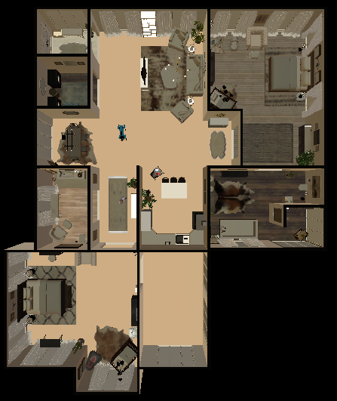
Experimental Settings
Sample Instructions
“Human: Dust all of the books in the living room and arrange them on the tables. Robot: Navigate to various objects in the scene.”
“Human: Help me set up a table for lunch in the living room. Place 3 forks, 2 spoons, a piece of bread, and sushi mat on the table. Robot: Navigate to various objects in the scene.”
"Human: Please put an apple in the fridge, my credit card on the bedside table, and the teapot on the living room table. Robot: Navigate to various objects in the scene."

Slide 12
Experimental Settings
Sample Objects
Object Name | Internal Handle
apple_0 | Apple_10_:0000
apple_1 | Apple_21_:0000
apple_2 | Apple_8_:0000
credit_card_3 | CreditCard_2_:0000
teapot_4 | c7a409e41936a6b12e017b30d9328aac5bf0de93_:0000
box_5 | Box_15_:0000
jug_6 | 79590e37b261153df0b50a05e90edf40bc4f13c0_:0000
box_7 | Office_Depot_Canon_CLI_8Y_Ink_Cartridge_Yellow_0623B002_:0000
clock_8 | dfc9026e1433b4f18ee76e7c6784e9406489a8c3_:0000
vase_9 | b5a2e303c9a5cfa54fb5b257cd82926b194e1e26_:0000
Notes:
Episode 39
Object Names to Handles:
apple_0 : Apple_10_:0000
apple_1 : Apple_21_:0000
apple_2 : Apple_8_:0000
credit_card_3 : CreditCard_2_:0000
teapot_4 : c7a409e41936a6b12e017b30d9328aac5bf0de93_:0000
box_5 : Box_15_:0000
jug_6 : 79590e37b261153df0b50a05e90edf40bc4f13c0_:0000
box_7 : Office_Depot_Canon_CLI_8Y_Ink_Cartridge_Yellow_0623B002_:0000
clock_8 : dfc9026e1433b4f18ee76e7c6784e9406489a8c3_:0000
vase_9 : b5a2e303c9a5cfa54fb5b257cd82926b194e1e26_:0000

Slide 13
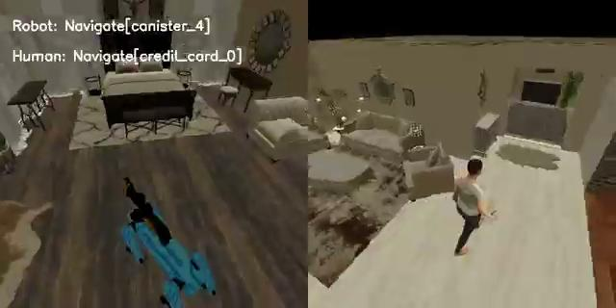
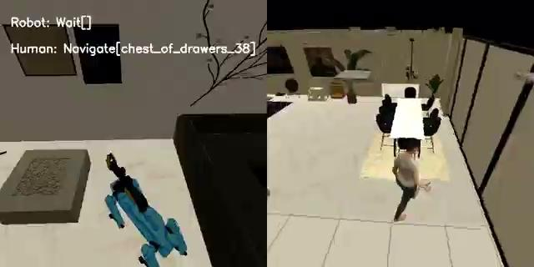
Example Episode Run
Instruction: Human: Help me organize my living room. Place three credit cards, a gaming console, and a canister on a chair. Robot: Navigate to various objects in the scene.
Human with Robot
Human-Only

Slide 14
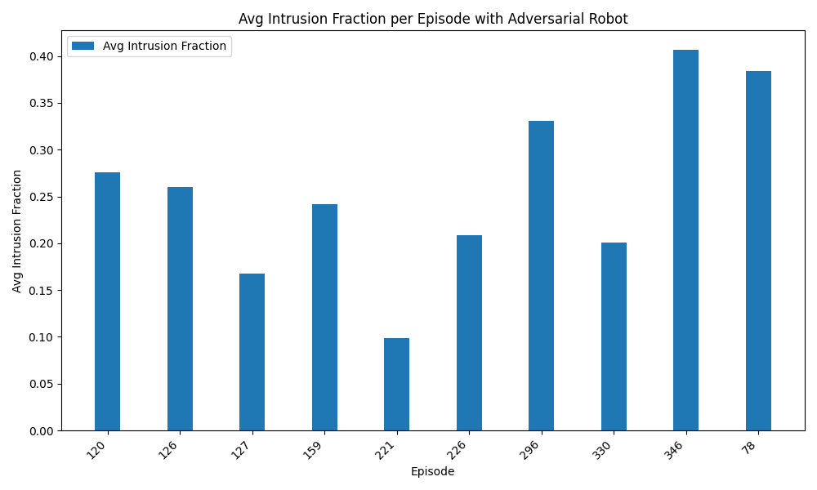
Results
We measure the average intrusion fraction of habitat baseline, and the results are far from desirable.
Notes:
measure intrusion threshold distance vs completion to see reaction of robot toward human overtime
measuring against human only does not make sense, hard to model human properly, should compare different robot behaviour instead
measure robot completion time

Slide 15
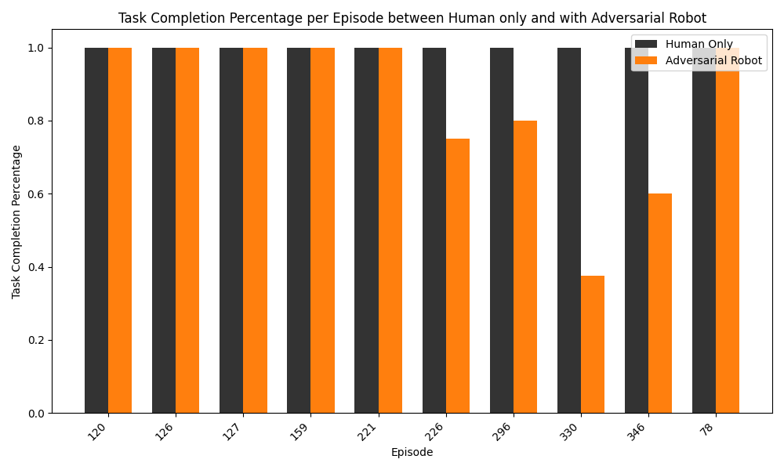
Results
For the baseline, the task completion rate drops significantly for some episodes when introducing the robot.

Slide 16
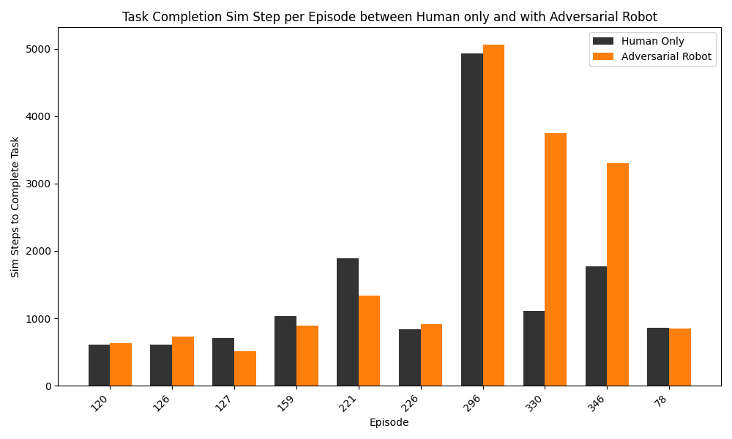
Results
For the baseline, human needs more time to complete tasks most of the time when introducing the robot.

Slide 17
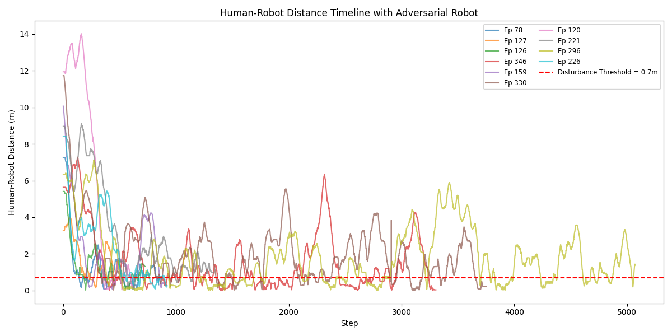
Results
Intrusion threshold: 0.7 m; visualize human–robot distance over time.

Slide 18




Future Directions
Real-world testing
Test across additional layouts and households
Object selections for navigating to maximize observation
Evaluate human comfort and perception

